Slide 1
INTRODUCTION TO REACTIONS INVOLVING SUBSTITUTION
Nucleophilic and Electrophilic substitution reactions

Slide 2
Addition reaction
The reaction in which a small molecule combines with an unsaturated-molecule.
Example
C₂H₄ + Br₂→C₂H₄Br₂

Slide 3
Substitution reaction
The reaction in which an atom or group of atoms is/are replaced by another atom or group of atoms.
Example
C₂H₅OH + HBr→ C₂H₅Br + H₂O

Slide 4
Elimination reaction
The reaction in which a small molecule is removed from a comparatively larger molecule forming an unsaturated compound.
Example
C₂H₅Br + NaOH→C₂H₄+H₂O+NaBr

Slide 5
types of attacking reagents
Electrophile(or electrophilic reagent)
Electrophileis an electron-deficient (or electron loving) chemical species. Due to the electron-deficiency, it always attacks at the centre of high electron-density. Eloctrophiles are classified into:
(a) Positive electrophiles, e.g., H⁺, H₃O⁺, Cl⁺, Br⁺, I⁺, , R⁺ (carbocation) , etc.
(b) Neutral electrophiles, e.g., R (free radical), BF₃, A1C1₃, FeCl₃, RCOC1, SO₃, : CR₂ (carbene),: NR (nitrene), etc.

Slide 6
(ii) Nucleophiles(or nucleophilic reagent)
Nucleophile s an electron-rich (or nucleus-loving) chemical species. Due to the presence of a pair of free electrons, it always attacks at the centre of low electron-density. Neuclophiles are classified into:
(a) Negative nucleophiles, e.g., F⁻, CI⁻ Br⁻, I⁻ , OH⁻, CN⁻, OR⁻, NH₂⁻, RCOO⁻, R⁻ (carbanion), etc.
(b) Neutral nucleophiles, e.g., H₂O, ROH, NH₃, RNH₂, R₂NH, ROR, etc.
(c) Ambident nucleophiles: When a nucleophile has electron-rich centre on both sides, it is known as ambident nucleophilesuch as CN⁻ and NO₂⁻, CN⁻ can act as nucleophile from carbon side as well as nitrogen side. Likewise, NO₂⁻ can act as nucleophile from oxygen side as well as nitrogen side.

Slide 7
Free radical addition reactions
These reactions are brought about by free radicals,
Example: Addition of HBr to propene in presence of peroxide.

Slide 8
TYPES OF SUBSTITUTION REACTION
Nucleophilic substitution reaction
This type of reaction involves displacement reaction brought about by stronger nucleophile (an electron-rich species), thereby displac­ed weaker nucleophile from the molecule.
Example: Hydrolysis of alkyl halide withaqueous alkali (aqKOH).

Slide 9
Two-step substitution mechanism (S_{N}1) involves two steps:
(a) In slow first step, old bonds break, and (b) in fast second step, new bonds are formed Thus:
Example:
The nucleophilic substitution of tert-butyl bromide.

Slide 10
Electrophilic substitution reaction
It is a substitution reaction of a hydrogen atom on the benzene ring brought about by an electrophile (an electron deficient species).
Example 1
Halogenation of arenes

Slide 11
types of elimination reaction
β-Elimination reaction
This type of reaction involves the loss of two atoms or groups from the adjacent carbon atoms of the molecule,
Example: Base-catalyseddehydrohalogenation of propyl bromide.
α-Elimination reaction
This type of reaction involves the loss of two atoms or groups from the samecarbon atom of the molecule.
Example:
Base-catalyseddehydrohalogenation of Chloroform to form dichlorocarbene

Slide 12
mechanism of elimination reaction
E1 Mechanism
Two-steps elimination reaction mechanism (El) involves :
Step 1 : Heterolytic fission to yield carbocation.
Step 2:Elimination of proton from β-carbon atom to produce the alkene.

Slide 13
mechanism of elimination reaction
Example
The formation of 2-methylpropene (isobutylene) from tert-butyl chloride on heating with alcoholic KOH:

Slide 14
mechanism of elimination reaction
E2 Mechanism
One-step elimination reaction mechanism (E2) occurs in primary alkyl halides. This reaction mechanism involves the abstraction of a proton by base from the carbon atom and simultaneous release of nucleophile ( ) from the α-carbon atom of the alkyl halide molecule.

Slide 15
Dieckmann condensation
It is an intramolecularClaisen condensation and is useful for the preparation of cyclic ketones. Diesters of C₆ and C₇ dibasic acids give good yields of cyclic β-keto-esters. Thus, ethyl esters of adipic and pimelic acids (1 and 3) give 2-carboxycyclopentanone (2) and 2-carboethoxy cyclohexanone(4), respectively.

Slide 16
RING OPENING REACTIONS

Slide 17
Synthesis of commonly used drug molecule
Synthesis of Paracetamol

Slide 18
Synthesis of commonly used drug molecule
Synthesis of Aspirin

Slide 19
Oxidation and Reduction Reactions
Oxidation
A large number of reactions inorganic chemistry involves oxidation. Oxidation for an organic compound is the addition or gain of oxygen or removal of hydrogen. Thus, oxidation of an aldehyde to a carboxylic acid or conversion of ethylene into ethylene oxide involves addition of oxygen. On the other hand, oxidation of ethanol to acetaldehyde involves removal of hydrogen.

Slide 20
Oxidizing Agents
Potassium permanganate
Potassium permanganate, a derivative of heptavalent manganese is a very powerful oxidising agent.
Its reactivity depends on whether it is used in acid, neutral or basic conditions.
In acid solution, Mn(VII) is reduced to divalent maganese (II) with a net transfer of five electrons (MnVII→Mnll).
However, in neutral or basic medium, manganese dioxide is usually formed, corresponding to a three-electron change (MnVII→MnlV).

Slide 21
Oxidation of alcohols
Oxidation of alkenes
Oxidation of alkynes

Slide 22
Reduction
Like oxidation, reduction of organic molecules has played an important role in organic synthesis. Reduction is referred to as addition of hydrogen to an unsaturated group like a carbon-carbon double bond, a carbonyl group or an aromatic nucleus.

Slide 23
Reducing Agents
Lithium aluminium hydride
LiAlH₄ is prepared by the action of anhydrous aluminium chloride to a paste of lithium hydride in THF.

Slide 25
CONFORMATIONAL ANALYSIS OF n-BUTANE
Conformation
Structures arising from rotation about single bonds (or flipping of rings) are called conformations.
Conformational analysis
Determination of the relative stabilities of the conformations of a compound and interpretation of its properties (physical and chemical) in terms of conformation is referred to as conformational analysis.

Slide 26
The stability of a conformation depends on your main factors. These are:
Torsional strain
Angle strain
van der Waals strain and
Dipole-Dipole interactions

Slide 27
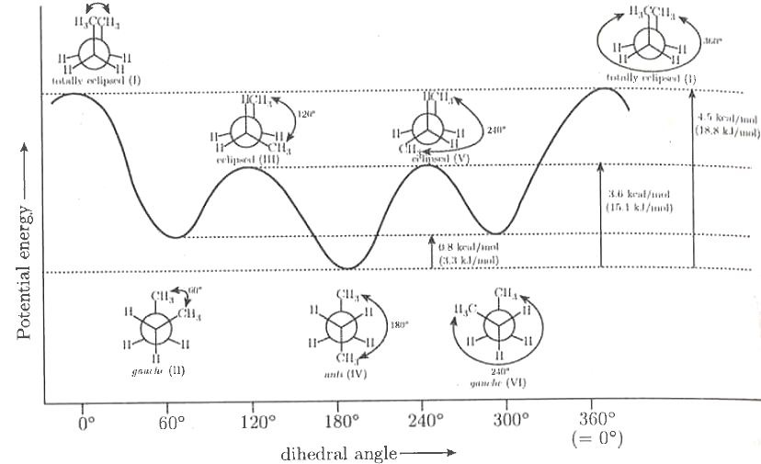
The order of increasing stability of the conformation of butane is as follows:

